Slide 1
DISCRETE
RANDOM VARIABLE

Slide 2
RANDOM VARIABLE
- a quantity whose value depends on chance

Slide 3
DISCRETE
whole number values
There is a clear separation between the values

Slide 4
Probability Distribution Table
List all possible values of the random variable and its probabilities

Slide 5
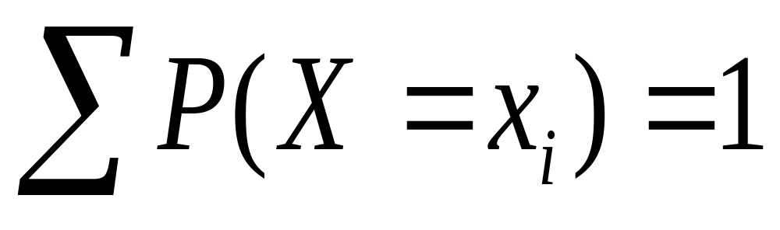
Important property of a RV

Slide 6

Example 1
X ~ r.v “ number of squares moved in a single throw of a dice”
x | 1 | 2 | 3 | 4 | 5 | 6
P(X=x)

Slide 7






Example 2
W ~ r.v “ number of squares moved is the sum of 2 scores”.
W | 2 | 3 | 4 | 5 | 6 | 7 | 8 | 9 | 10 | 11 | 12
P(W=w)

Slide 8
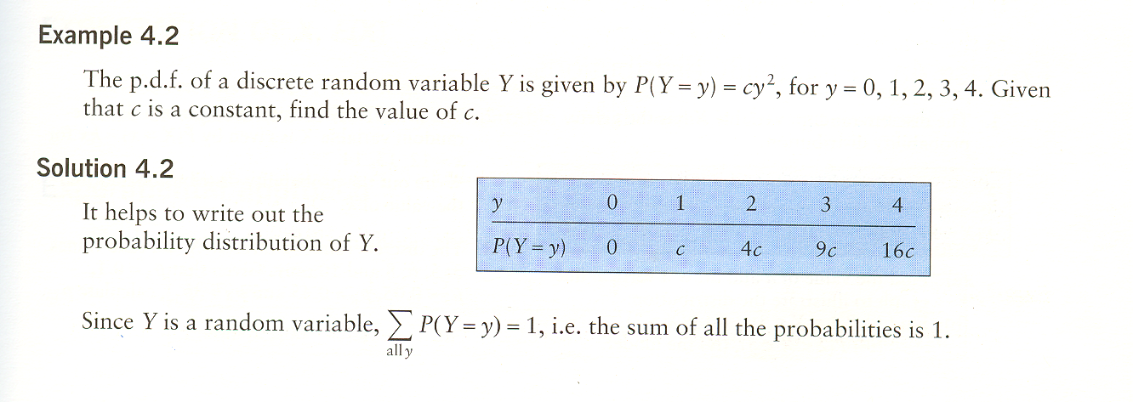

Slide 9
